Slide 1
Algorithms for Analysis of Genomic Sequence Data
Alexey V. Zimin
JHU BME 580.417/707

Slide 2
Week 1
Alexey V. Zimin
JHU BME 580.417.707

Slide 3
Introduction to the course
Professor: Alexey Zimin, https://ccb.jhu.edu/people/alekseyz/
Times: MWF, 3:00pm – 3:50pm
Location: Hodson 203
Office hours and location: Wyman Park building, second floor, S237, Mondays 2pm-3pm (before class).
Textbook: None, all lecture slides will be made available online
Attendance policy: attendance is mandatory, no video/audio lecture recordings will be made available online. Lecture slides will be available online. Attendance will be recorded with Iclicker. Please join the class at https://join.iclicker.com/PUOA. Attendance will not be recorded during the first week of class. Two unexcused absences are allowed.
GRADING POLICY: Attendance is worth 10%. Six laboratory assignments are worth 13% each. The in-class presentation is worth 12%.
The pace of the course may be adjusted as we go through the semester.

Slide 4
More on the grades
Lab assignments will include writing a code to accomplish certain task and may include additional task to plot outputs (depending on the assignment)
You can write code in python, all code submissions will be handled and graded by GradeScope
You can ask AI (e.g. ChatGPT, Claude or MS Copilot) to help you with writing the code, however, the you must understand that an AI will always provide very similar code when prompted. If several students submit very similar code, this will be flagged in GradeScope, and may become grounds for investigation for cheating

Slide 5
Reading list and presentations
There will be no final exam
I shared a Google Sheet listing a set of papers on genome assembly/annotation (in the online version of the syllabus)
Each student can choose a paper they will read (you are welcome to read more than one)
Each student will then prepare a 10-minute presentation on an aspect of a paper related to what we studied in class.
The presentations will be scheduled during the last three weeks of the course, and they are worth 12% of the grade
You must show that you’ve read the paper. Reading AI-prepared presentation notes from your phone screen will not earn you full credit

Slide 6
Concepts we will learn
Basics of DNA/RNA sequencing
Alignment of DNA/RNA/AA sequences, suffix arrays, BW transform, Smith-Waterman alignment
Assembly methods of DNA/RNA sequencing data and corresponding data structures: k-mer and overlap graphs
Evaluation of assemblies
Making sense of the genomic sequence -- introduction to genome annotation, use of deep learning in genome annotation

Slide 7
Computing facilities
I designed most of the lab assignments to be light on the data/computing, a laptop with 8-16Gb of RAM and a few Gb of available disk space will be enough for the labs
You can use campus computing facilities that are available to you
Talk to me after class if you need computer access

Slide 8
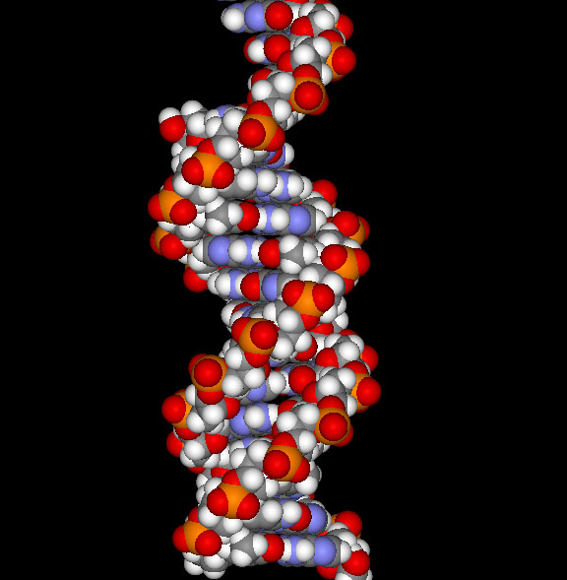
What is DNA?
Most cells in all living beings have a DNA molecule in their nucleus
DNA abbreviates DeoxyriboNucleic Acid
Determines the structure, function, and behavior of the cell
Linear, double-stranded, helical molecule.
Consists of four types of nucleotides (bases):
adenine (A)
thymine (T)
guanine (G)
cytosine (C)

Slide 9
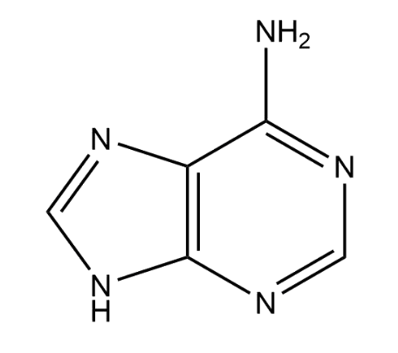
Nucleotide: Phosphate, Base and Pentose sugar
OH
Pentose sugar (Ribose)
O
P
O
OH
C(5’)
O
OH
C(4’)
C(1’)
OH
Phosphate
Base (A)
C(3’)
C(2’)
OH
OH

Slide 10
Nucleotide: Phosphate, Base and Pentose sugar
OH
Ribonucleotide reductase (RNR) makes DeoxyRibose
O
P
O
OH
C(5’)
O
OH
C(4’)
C(1’)
OH
Phosphate
Base (A)
C(3’)
C(2’)
OH

Slide 11
Nucleotide: Phosphate, Base and Pentose sugar
OH
DeoxyRibose
O
P
O
C(5’)
O
OH
C(4’)
C(1’)
OH
Phosphate
C(3’)
C(2’)
Base (A)
OH

Slide 12
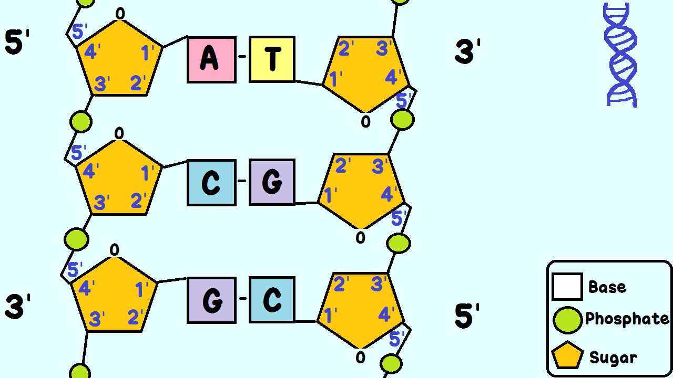
DNA replication
DNA polymerase reads from 3’ end to 5’ end and synthesizes (writes) from 5’ to 3’ direction (Image by GiGa Group)

Slide 13
Complementary strands
DNA is double-stranded : 5’ forward strand direction -> AGATAGACATAGACATAGACAGATACACTCGATCG ||||||||||||||||||||||||||||||||||| TCTATCTGTATCTGTATCTGTCTATGTGAGCTAGC <-5’ reverse strand direction
These two sequences are the SAME: AGATAGACATAGACATAGACAGATACACTCGATCG or CGATCGAGTGTATCTGTCTATGTCTATGTCTATCT

Slide 14
DNA extraction
Lysis: This step breaks open cells to release DNA into solution. Lysis can be achieved through physical, chemical, or enzymatic methods.
Separation: After lysis, the DNA needs to be separated from cellular debris, proteins, and other macromolecules. This can be done through methods like salting out, precipitation with alcohol, or magnetic bead separation.
Purification: Once separated, the DNA is further purified to remove any remaining contaminants. This can involve techniques like silica-based column purification, or washing the DNA pellet with ethanol.
Concentration: Finally, the DNA is concentrated by removing the remaining liquid through methods like vacuum centrifugation or lyophilization.

Slide 15
DNA Extraction -Video
Video demonstration of strawberry DNA extraction
DIY DNA Extraction!

Slide 16
Library preparation
Fragmentation: DNA is fragmented by mechanical or chemical (restriction enzyme) means
DNA end repair: ends are repaired by incorporating missing nucleotides AGATAGACATAGACATAGACAGATAC ||||||||||||||||||||||||||||||||||| TGTATCTGTATCTGTCTATGTGAGCTAGC
Size selection: fragments of target size are pulled out:
Gel electrophoresis
Magnetic beads

Slide 17
Library preparation
Fragmentation: DNA is fragmented by mechanical or chemical (restriction enzyme) means
DNA end repair: ends are repaired by incorporating missing nucleotides AGATAGACATAGACATAGACAGATACACTCGATCG ||||||||||||||||||||||||||||||||||| TCTATCTGTATCTGTATCTGTCTATGTGAGCTAGC
Size selection: fragments of target size are pulled out:
Gel electrophoresis
Magnetic beads

Slide 18
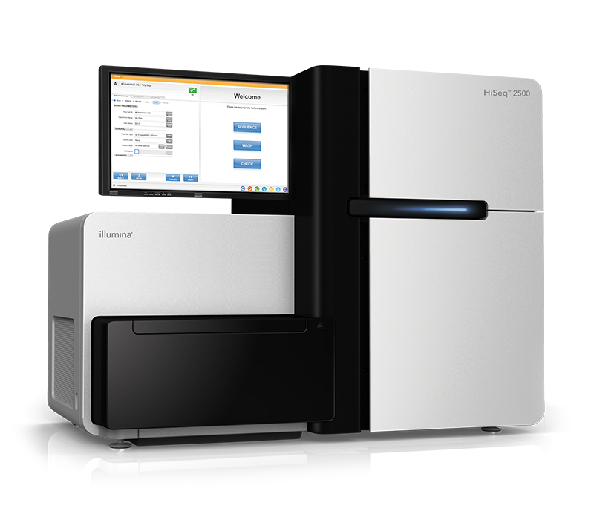
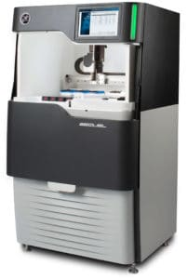
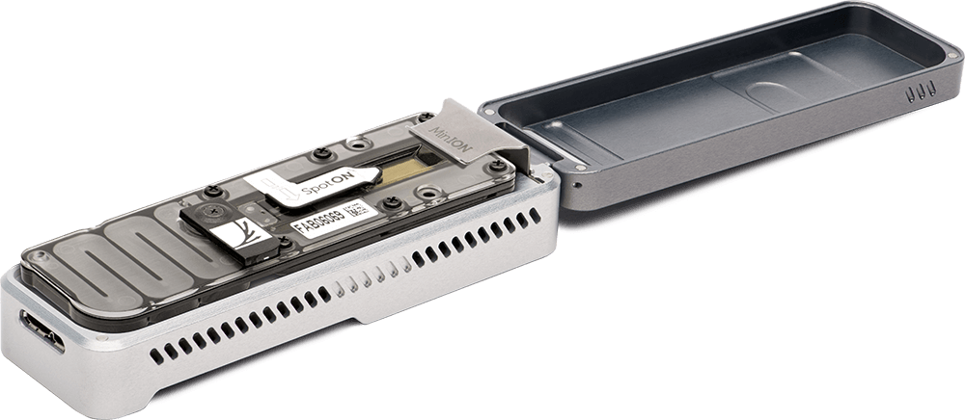
DNA sequencing overview
Multiple copies of DNA
Fragments of
150 - >500,000 bases
Read the Sequences
Extract, Shred &
(Size select)

Slide 19
DNA sequencing data: (pairs of) reads
Sequencing machines output letters of DNA and estimated quality scores
Two types of data:
Reads
Pairs of reads
A read is a sequence of letters read from a forward or reverse strand
Letters (bases) typically have quality scores

Slide 20
Types of sequencing reads
Single-end reads: PacBio HiFi or Oxford Nanopore: 5’ direction -> AGATAGACATAGACATAGACAGATACACTCGATCG TCTATCTGTATCTGTATCTGTCTATGTGAGCTAGC <-5’ reverse strand direction
You get: AGATAGACATAGACATAGACAGATACACTCGATCG or CGATCGAGTGTATCTGTCTATGTCTATGTCTATCT

Slide 21
Types of sequencing reads
Paired-end reads: Illumina 5’ direction -> AGATAGACATAGACATAGACAGATACACTCGATCG TCTATCTGTATCTGTATCTGTCTATGTGAGCTAGC <-5’ reverse strand direction
You get: AGATAGACATA and CGATCGAGTGT

Slide 22
Current DNA sequencing technologies
Short Reads: Illumina
☺ Cheap: as low as $1K for de novo human genome
☺ Accurate: ~1% error rate
☹ Only 150 to 300 bp reads, paired ends of 300-800bp fragments
Long Reads: Oxford Nanopore and PacBio HiFi
☺ Inexpensive: $2-5k for a de novo human genome
☺ We get on average long 10-500Kbp reads
☹ High error rate: ~3-7% for ONT, <1% error rate for HiFi

Slide 23
Repeat regions cause mistakes
A
R
B
R
C
A
R
C

Slide 24
Long reads help avoid mistakes
A
R
B
R
C

Slide 25
Sequencing data formats
FASTA -- sequence with optional quality scores in a separate file (space-separated numbers)
FASTQ -- sequence with quality scores (Phred-encoded)
SAM/BAM -- sequence with quality scores and optional alignments to a genome

Slide 26
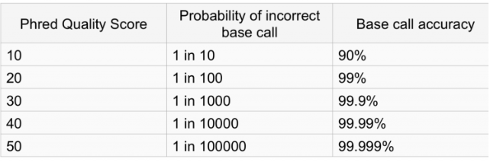
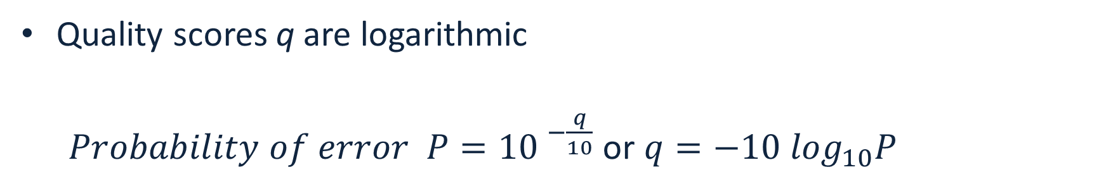
Quality score
Quality scores q are logarithmic
$Probability of error P={10 }^{−\frac{q}{10}}$ or $q=−10 \log_{10}P$
https://learn.gencore.bio.nyu.edu/ngs-file-formats/quality-scores/

Slide 27
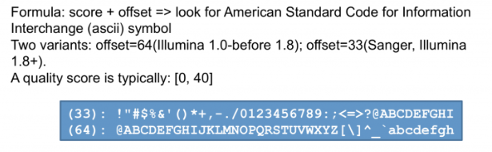
Phred33 vs Phred64 encoding
Phred (Phil's Read Editor^{[1]}) -- the name of the first program to compute quality scores in Sanger sequencing data by Phil Green
Quality scores q are encoded with characters
Offset may differ – most common now is 33 (Phred33)
https://learn.gencore.bio.nyu.edu/ngs-file-formats/quality-scores/

Slide 28
Fasta format
Header line: >seq_name attribute1 attribute2
Sequence, each line no longer than 80 characters (convention): AGCATAGACATATAGCAT AGATAGATCAGATAG
Optional accompanying file of quality scores, same format

Slide 29
Example fasta/qual format
FASTA file:
>sequence1 tag1=value1
AGATAG
>sequence2 tag1=value1
AAGAATA
QUAL file:
>sequence1 tag1=value1
7 7 8 1 60 60
>sequence2 tag1=value1
50 40 30 20 10 5 5

Slide 30
Fastq format
Each sequence definition starts with “@”, sequence name immediately follows
^@ line may contain more space-separated fields
Next set of lines is the sequence (ACGTN), no limit on the line length
New line starting with “+” ends sequence; sequence name may be duplicated after the “+”
Phred33(or 64) quality scores follow. Number of characters equal to the number of letters in the sequence
“@” symbol may appear in the quality scores!!!

Slide 31
Example fastq format
@read1 property=value someotherstuff
NAGCATGACATAGAC
+
D@JNDKJNDKSSSNS
@read2 property=value someotherstuff
NGAGATCATGACTAG
+
KIDBDHBJSHAJHS3

Slide 32
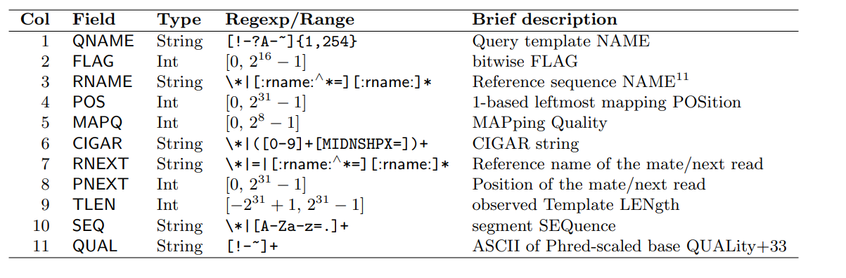
BAM/SAM format
Tab-separated file, human readable with the following columns
Missing or not defined values are *

Slide 33
BAM/SAM format
Tab-separated file, human readable with the following columns
Missing or not defined values are *

Slide 34
SAM/BAM and samtools
BAM files are compressed SAM files
samtools is a useful utility to work with SAM/BAM files
Frequently used options
samtools view: SAM ⬄ BAM conversion
samtools sort: sort SAM/BAM file
samtools fastq: convert BAM/SAM to fastq

Slide 35
Lab 1: Convert fastq to fasta
Goals: write a python script that reads a fastq file from stdin, converts it to fasta and outputs to stdout; familiarize yourself with GradeScope
There may be one or more than one sequence in the fastq file
Name your program fastq_to_fasta.py
Do not assume that sequence/quality are on a single line. Remember: number of characters in the sequence (before line starting with “+”) specifies how many characters of quality you must read
Fail and exit with an error if the number of characters in sequence is different from the number of qual characters
Due date: September 11, 8:00pm.
Submit your code to GradeScope, it will be graded automatically right away, you have unlimited submission attempts until due date

Slide 36
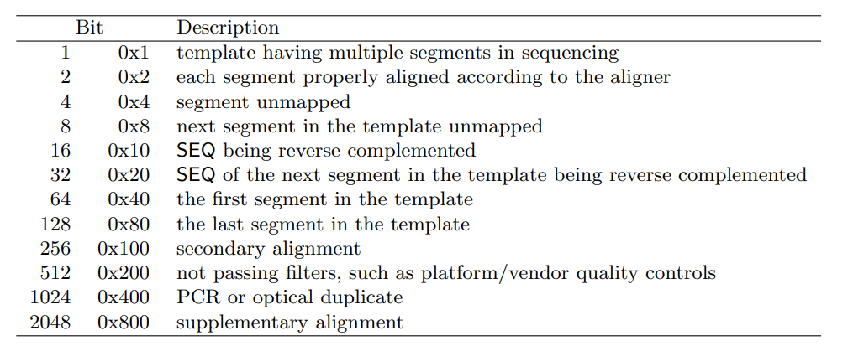
SAM format
FLAG field – 11 bits represented as decimal number
Most often used are 0 and 16
Conversion 000000010000₂ = 16, 010000010101₂ = 1024+16+4+1=1045

Slide 37
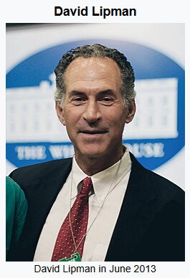
National Center for Biotechnology Information
National Center for Biotechnology Information (NCBI) is now the biggest part of National Library of medicine (NLM)
NCBI was founded in 1988
Dr. David Lipman, a key developer of the FASTA algorithm, was appointed as the first NCBI Director.
Leading source for
public biomedical databases
software tools for analyzing molecular and genomic data, and research in computational biology.
>40 integrated databases for the medical and scientific communities as well as the general public.
Image: Wikipedia

Slide 38
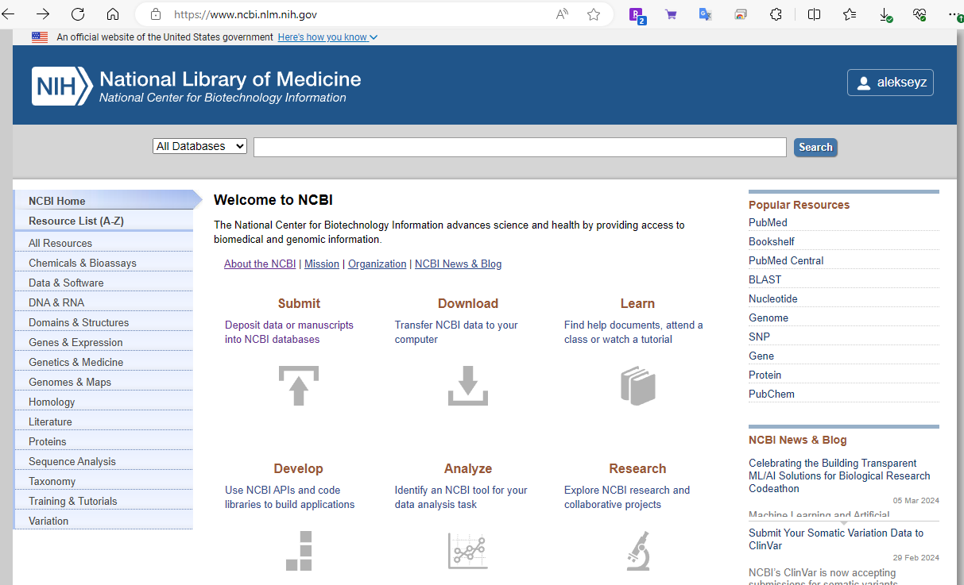
National Center for Biotechnology Information
NCBI hosts:
GenBank: repository of draft genomes
RefSeq: repository of high(er)- quality genomes
Sequence Read Archive or the SRA: the biggest repository of the sequencing data
And many others (genes, proteins, literature, clinical trials, etc …)

Slide 39
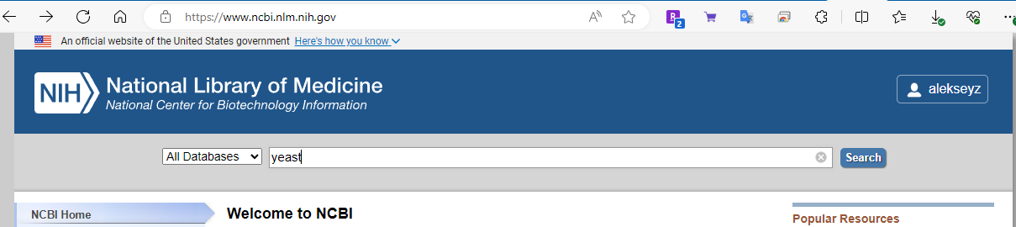
Finding information at NCBI

Slide 40
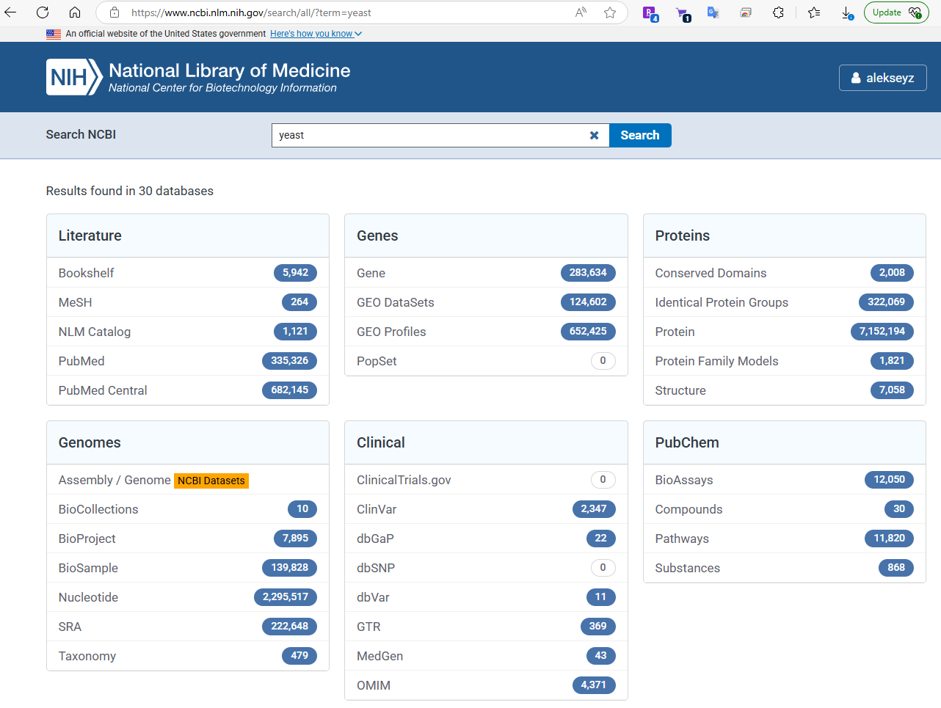
Finding information at NCBI

Slide 41
Finding information at NCBI

Slide 42
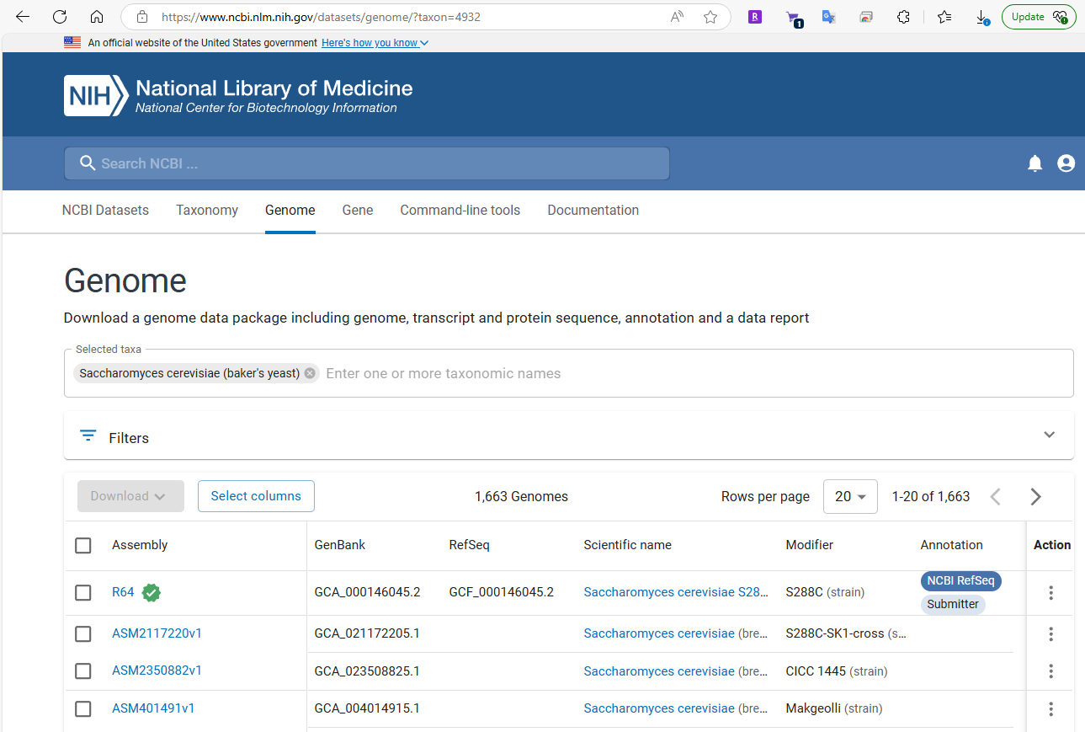
Finding information at NCBI:GenBank/RefSeq

Slide 43
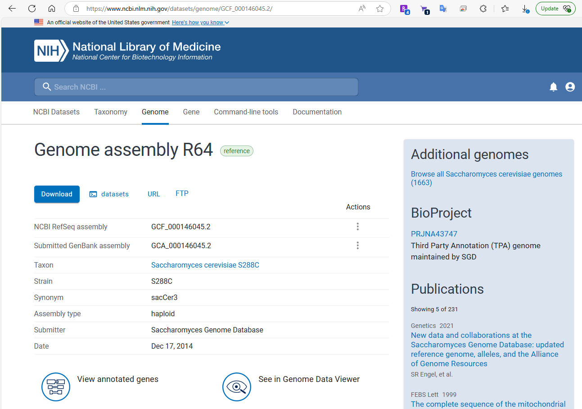
Finding information at NCBI:GenBank/RefSeq

Slide 44
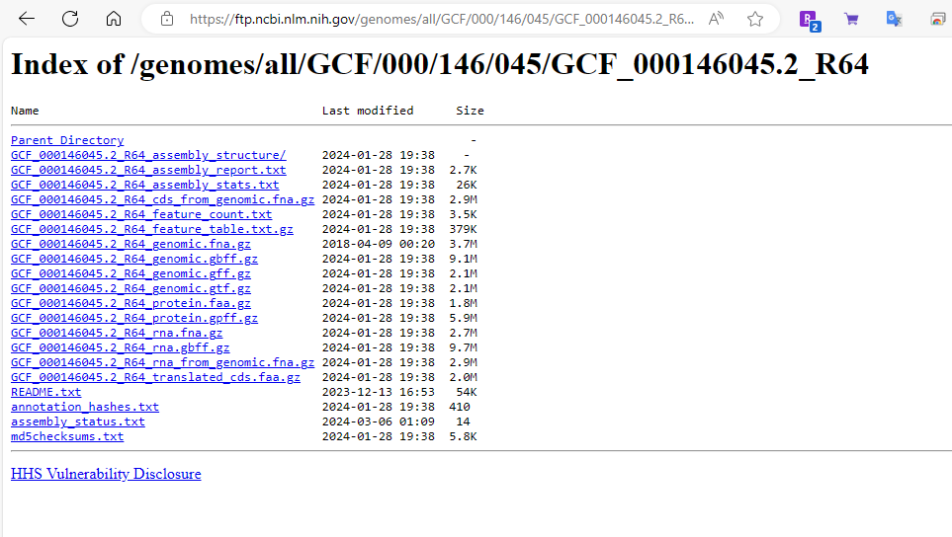
Finding information at NCBI:GenBank/RefSeq
Right-click on the link and choose “Copy link”
Then go to your terminal and type wget and paste the link:
wget paste_the_link_here

Slide 45
Finding information at NCBI:GenBank/RefSeq

Slide 46
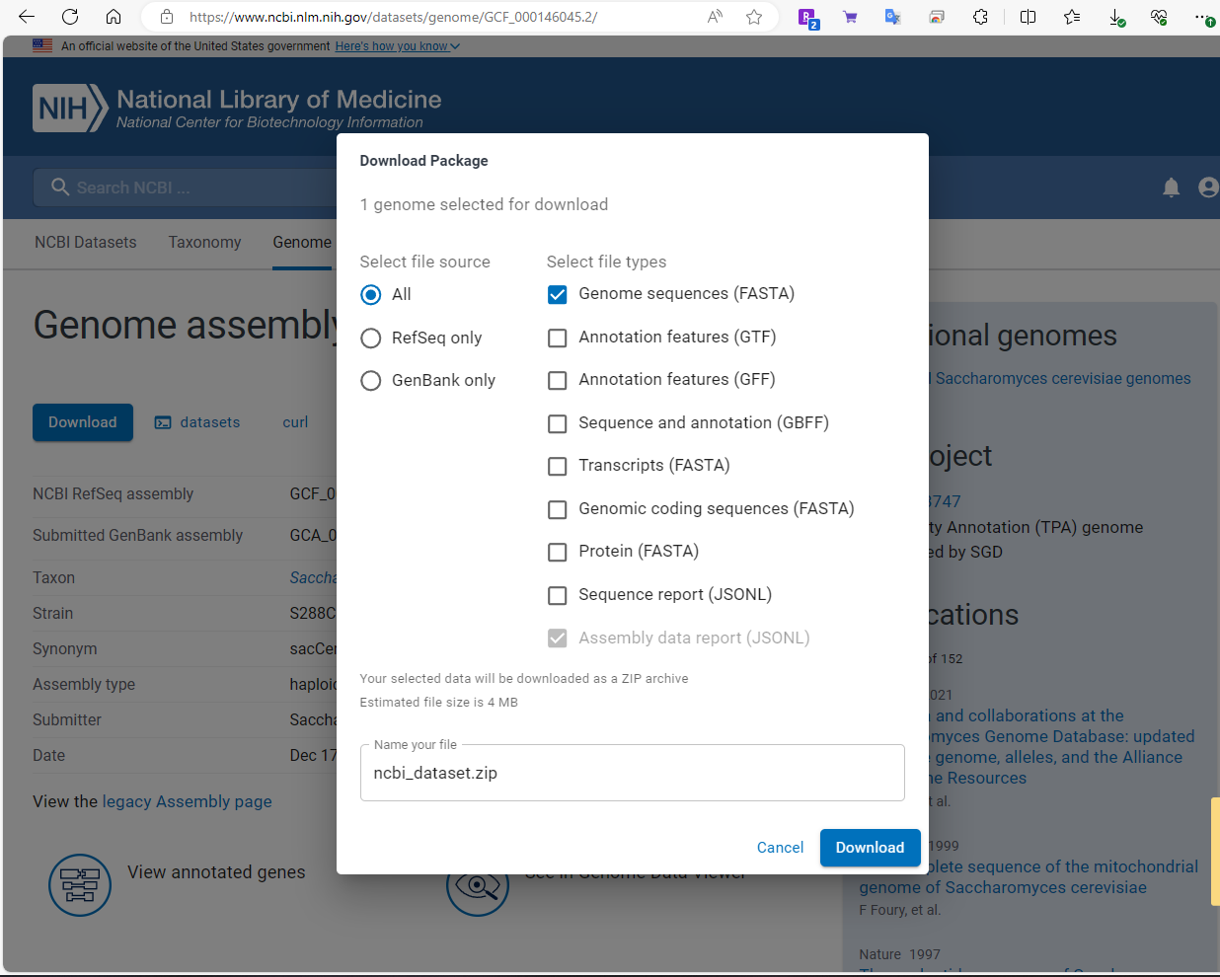
Finding information at NCBI:GenBank/RefSeq

Slide 47
Finding information at NCBI:GenBank/RefSeq

Slide 48
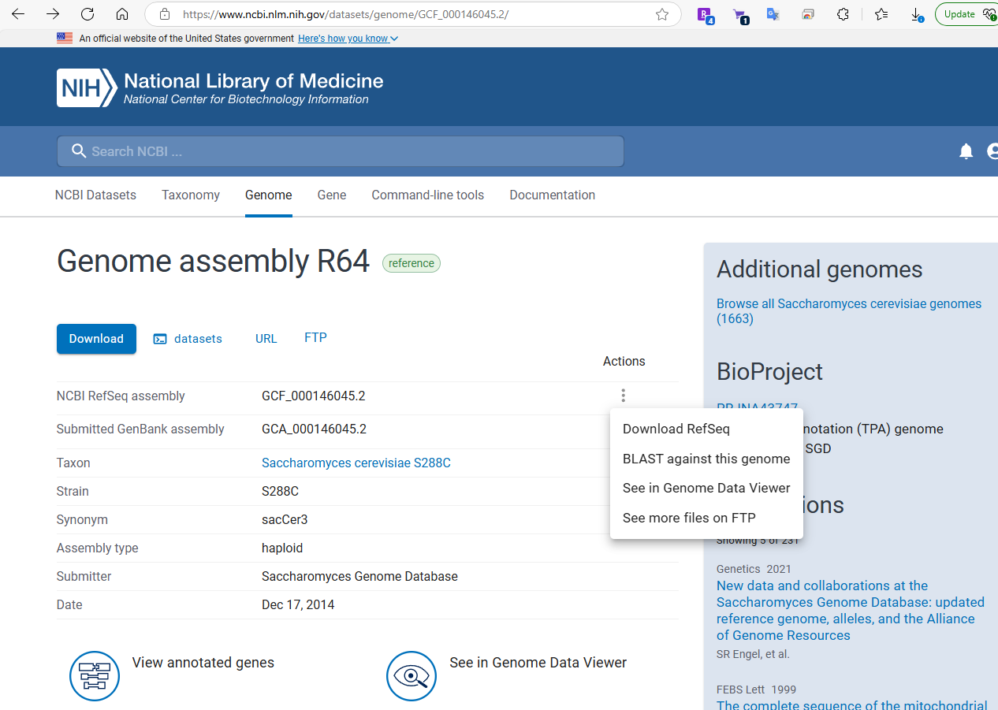
Finding information at NCBI:GenBank/RefSeq

Slide 49
Finding information at NCBI

Slide 50
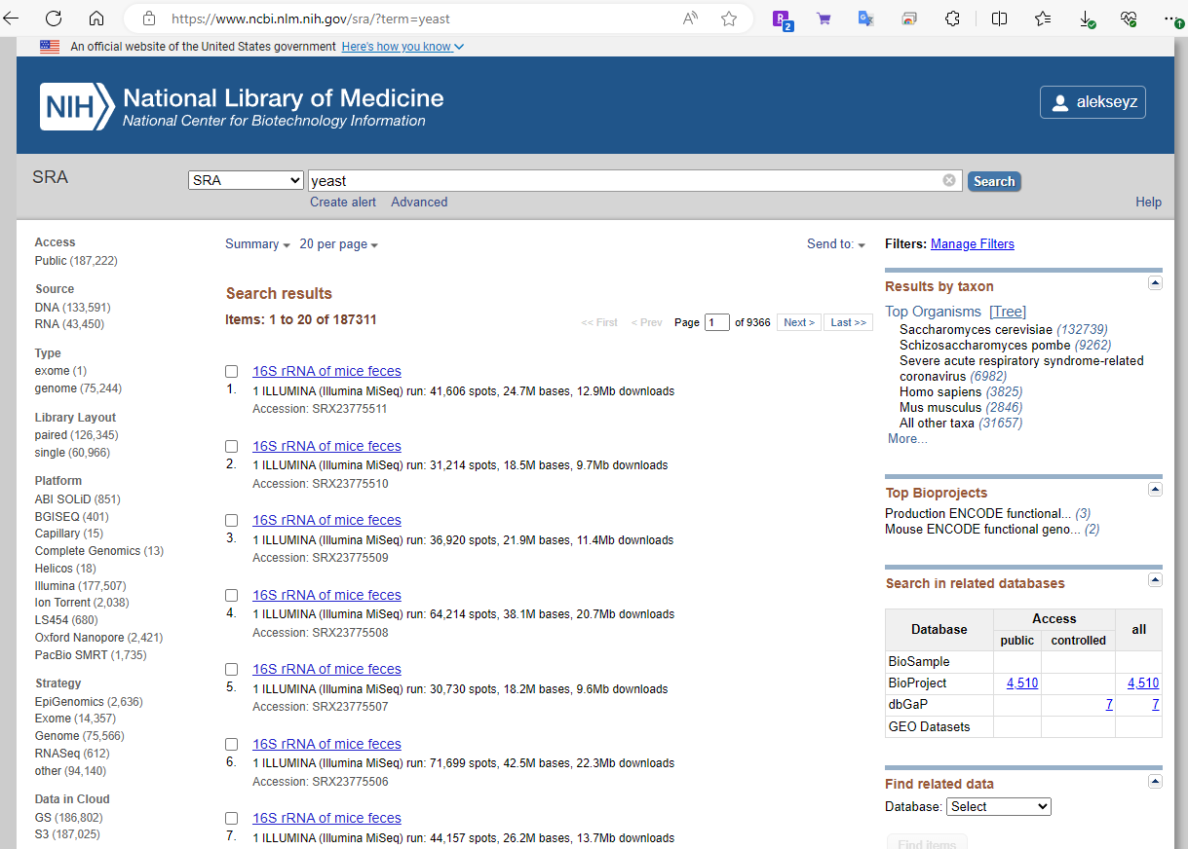
Finding information at NCBI:SRA

Slide 51
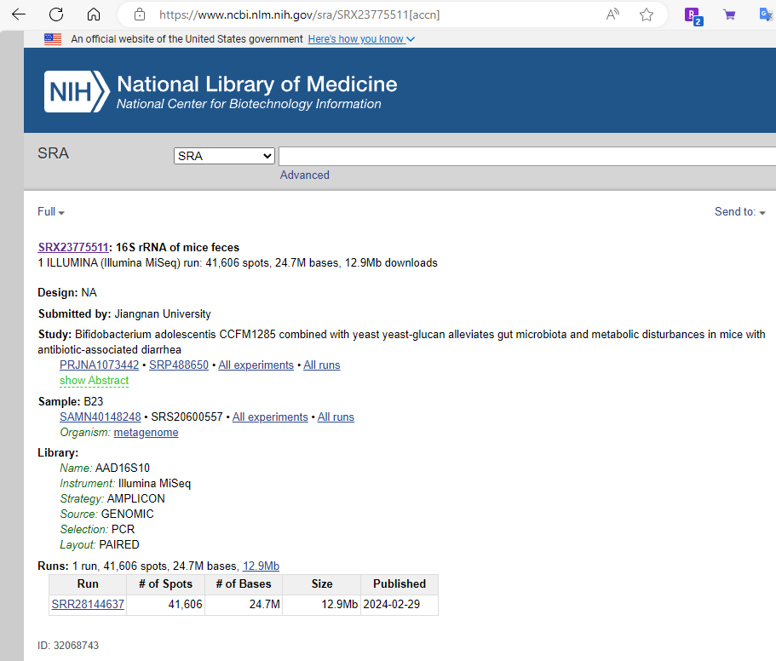
Finding information at NCBI:SRA

Slide 52
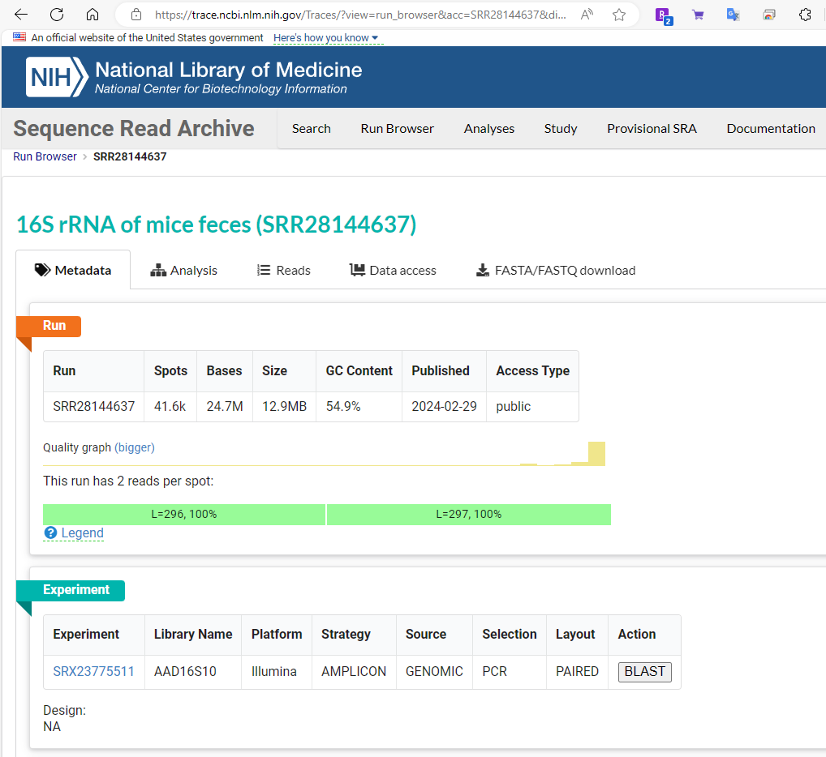
Downloading data from NCBI SRA: small sets
Using GUI at NCBI is the easiest way to download small data sets
For most data you have to use NCBI SRA toolkit

Slide 53
Downloading data from NCBI SRA

Slide 54
Using fastq-dump (part of sratoolkit)
sratoolkit is available from NCBI
fastq-dump is used to get data from NCBI SRA
fastq-dump --split-3 SRRXXXXXXXX
Produces files:
SRRXXXXXXXX_1.fastq – Illumina paired end forward reads
SRRXXXXXXXX_2.fastq and/or – Illumina paired end reverse reads
SRRXXXXXXXX.fastq – single-end reads

Slide 55
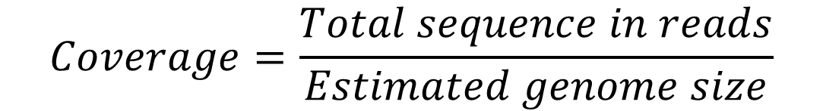
Coverage
Coverage refers to redundancy in sequencing data
Commonly expressed as <number>x, such as 20x, 30x, etc.
For paired reads one can compute coverage by reads and coverage by fragments
$$Coverage=\frac{Total sequence in reads}{Estimated genome size}$$
fragment or insert
read
AGATAGACATAGACATAGACAGATACACTCGATCG TCTATCTGTATCTGTATCTGTCTATGTGAGCTAGC
read

Slide 56
How much coverage is sufficient?
It depends… on read lengths
1x is enough if read length == chromosome length
In general read length << chromosome length
Problem: assume fixed read length << chromosome length
What is the probability of a gap?
Use Poisson distribution!

Slide 57
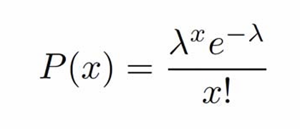
Poisson distribution
The Poisson distribution is a discrete probability distribution that expresses the probability of a given number of events occurring in a fixed interval of time if these events occur with a known constant mean rate and independently of the time since the last event.
The Poisson distribution is also the limit of a binomial distribution, for which the probability of success for each trial equals λ divided by the number of trials, as the number of trials approaches infinity

Slide 58
Poisson distribution and coverage
Let:
G genome length (in bp)
L read average length (L<<G)
N number of reads
Then:
λ, sequencing redundancy = N*L/G
x is the number of short reads covering a given site on the genome
For a given base on the genome for each read Prob(base covered)=L/G << 1; number of attempts (reads): N >> 1.
Genome coverage λ = NL/G is O(1). x=2 x=4 x=0

Slide 59
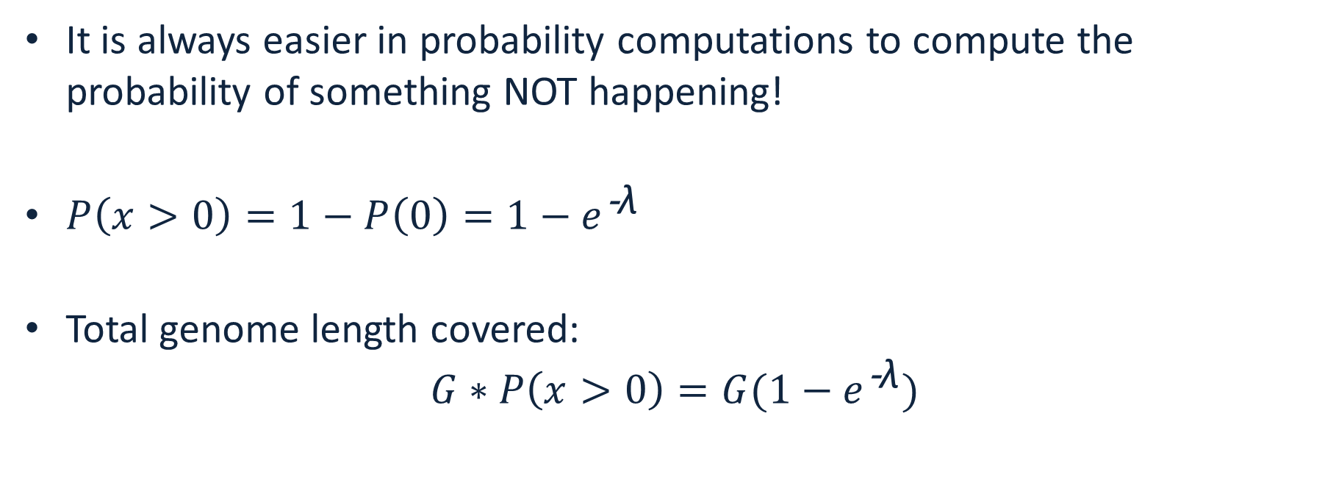
Fraction of the genome covered
It is always easier in probability computations to compute the probability of something NOT happening!
${P\left(x>0\right)=1−P\left(0\right)=1−e}^{\text{−}\text{λ}}$
Total genome length covered: ${G∗P\left(x>0\right)=G(1−e}^{\text{−}\text{λ}})$

Slide 60
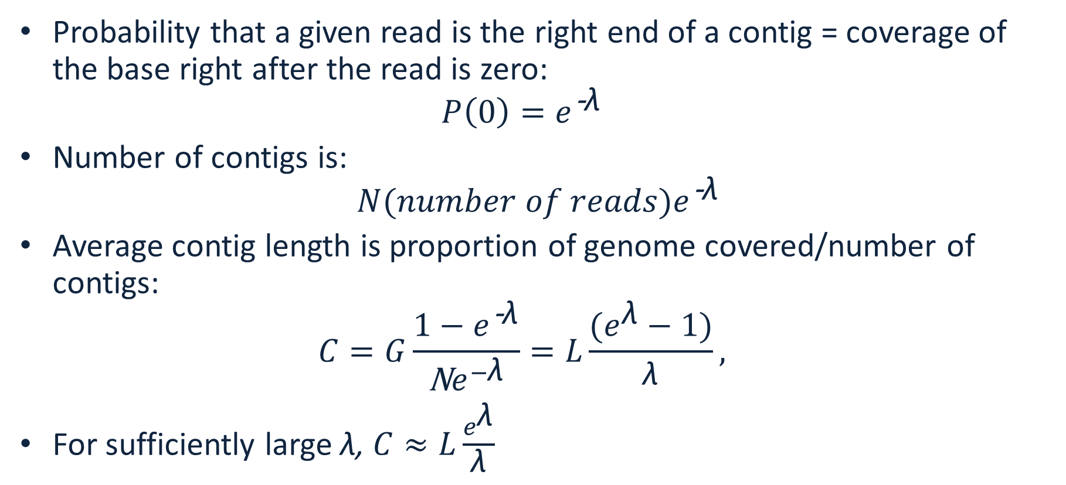
Number of contigs and average length
Probability that a given read is the right end of a contig = coverage of the base right after the read is zero: ${P\left(0\right)=e}^{\text{−}\text{λ}}$
Number of contigs is: ${N(number of reads)e}^{\text{−}\text{λ}}$
Average contig length is proportion of genome covered/number of contigs: $C=G\frac{{1−e}^{\text{−}\text{λ}}}{\text{N}e^{−\text{λ}}}=L\frac{(e^{\text{λ}}−1)}{\text{λ}},$
For sufficiently large λ, $C≈L\frac{e^{\text{λ}}}{\text{λ}}$

Slide 61
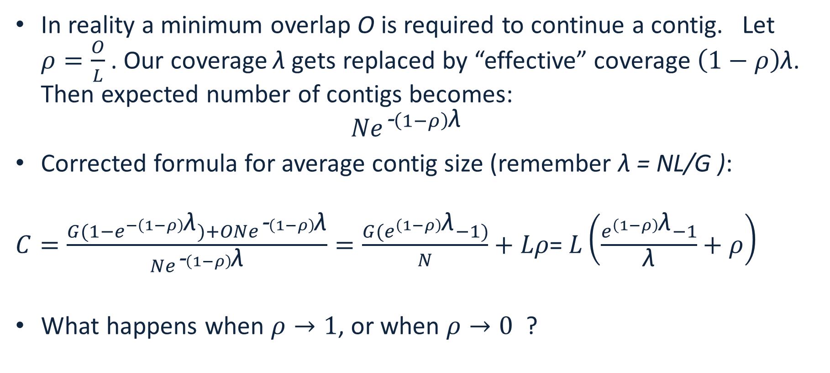
Real life correction to contig length
In reality a minimum overlap O is required to continue a contig. Let $ρ=\frac{O}{L}$. Our coverage $\text{λ}$gets replaced by “effective” coverage $\left(1−ρ\right)\text{λ}$. Then expected number of contigs becomes: ${Ne}^{\text{−}\left(1−ρ\right)\text{λ}}$
Corrected formula for average contig size (remember λ = NL/G ):
$C=\frac{{G(1−e}^{−\left(1−ρ\right)\text{λ}})+O{Ne}^{\text{−}\left(1−ρ\right)\text{λ}}}{{Ne}^{\text{−}\left(1−ρ\right)\text{λ}}}=\frac{{G(e}^{\left(1−ρ\right)\text{λ}}−1)}{N}+Lρ$= $L\left(\frac{e^{\left(1−ρ\right)\text{λ}}−1}{\text{λ}}+ρ\right)$
What happens when $ρ→1$, or when $ρ→0$ ?

Slide 63
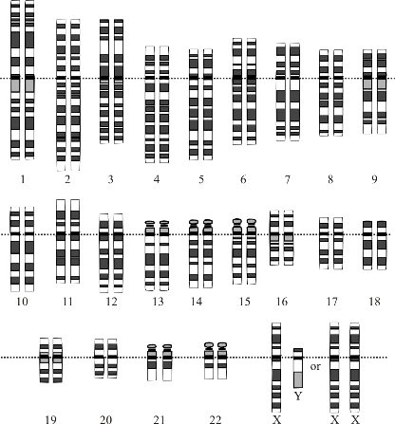
Overview
Multiple copies of DNA
Fragments of
150 - >500,000 bases
Read the Sequences
Shred &
(Size select)
Scaffolding
Pairs of Reads of ~150-250 bp each
Contig assembly
CAAGCTGAT...
…GTTTGGAAC
OR Long reads 10+ kb each
Image Courtesy: National Human Genome Research Institute

Slide 64
Repeat regions cause mistakes
A
R
B
R
C
A
R
C

Slide 65
Long reads help avoid mistakes
A
R
B
R
C

Slide 66
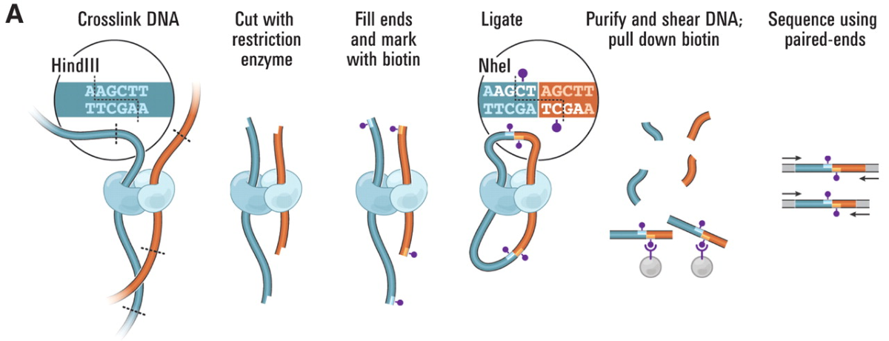
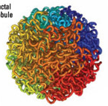
Types of sequencing reads
Proximity ligation or Hi-C libraries
Sequenced with paired-end Illumina
Images from: Van Berkum NL, Lieberman-Aiden E, Williams L, Imakaev M, Gnirke A, Mirny LA, Dekker J, Lander ES. Hi-C: a method to study the three-dimensional architecture of genomes. Journal of visualized experiments: JoVE. 2010(39).

Slide 67
Coverage
Coverage refers to redundancy in sequencing data
Commonly expressed as <number>x, such as 20x, 30x, etc.
For paired reads one can compute coverage by reads and coverage by fragments
$$Coverage=\frac{Total sequence in reads}{Estimated genome size}$$
fragment or insert
read
AGATAGACATAGACATAGACAGATACACTCGATCG TCTATCTGTATCTGTATCTGTCTATGTGAGCTAGC
read

Slide 68
Choosing the right sequencing strategy
The right sequencing strategy depends on your budget and availability of sequencing services
The simplest strategy: get 20-30x genome coverage with PacBio HiFi reads
Alternative strategy: get 30-40x genome coverage with Oxford Nanopore reads + 30-50x coverage with Illumina reads
Perform hybrid assembly
Assemble ONT reads and then polish with Illumina
For chromosome-sized scaffolds you may need HiC reads

Slide 69
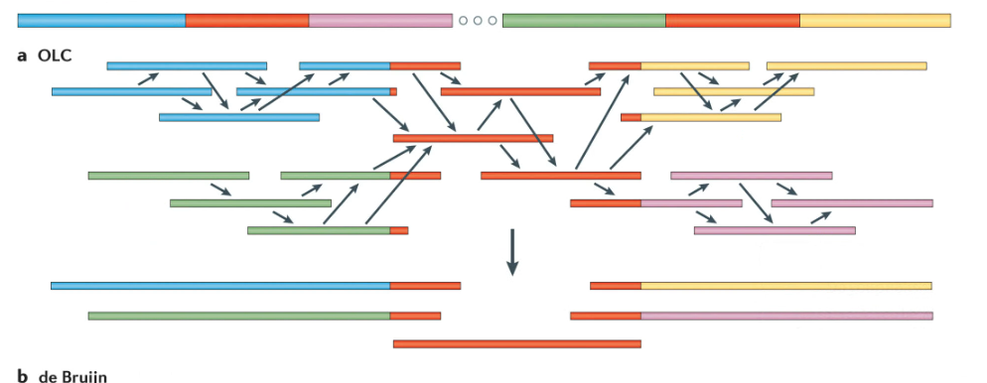
General genome assembly paradigms
Overlap – compute overlaps between reads based on sequence alignments
Layout – produce a graph of overlapping reads, find linear paths
Consensus – generate contig sequences
Chaisson et al., (2015)

Slide 70
DeBruijn graph
Break reads into overlapping k-mers of fixed length K
e.g K=5 AGACATAGAC AGACA GACAT ACATA CATAG ATAGA TAGAC
Count all kmers in the reads, build a table of kmer-count AGACA 5 GACAT 20
Build k-mer graph, k-mers are nodes and k-1 exact overlaps are edges
Look for a linear paths through the graph

Slide 71
DeBruijn graph
Build k-mer graph, k-mers are nodes and k-1 exact overlaps are edges AGACA check continuations in both directions AGACA none A A -none none C C 5 none G G 10 15 T T -none

Slide 72
DeBruijn graph
Build k-mer graph, k-mers are nodes and k-1 exact overlaps are edges AGACA check continuations in both directions GACAC AGACA GACAG none A

Slide 73
DeBruijn graph
Build k-mer graph, k-mers are nodes and k-1 exact overlaps are edges AGACA check continuations in both directions GACAC AGACA none A GAGAG none C none G 15 T none A

Slide 74
DeBruijn graph
Build k-mer graph, k-mers are nodes and k-1 exact overlaps are edges AGACA check continuations in both directions GACAC TAGAC AGACA none A GAGAG none A

Slide 75
DeBruijn graph
Build k-mer graph, k-mers are nodes and k-1 exact overlaps are edges AGACA check continuations in both directions GACAC TAGAC AGACA none A GAGAG none A
Look for a path that visits all nodes (some nodes several times)

Slide 76
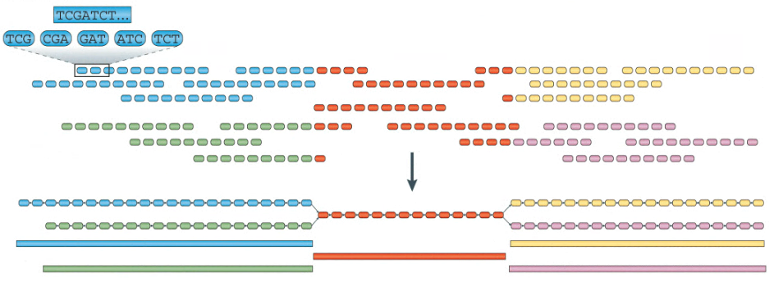
DeBruijn graph
Chaisson et al., (2015)

Slide 77
Assembly polishing
Contig sequence produced by assemblers contains errors, especially if ONT data was used: AGACATAGACGA*AGACATAGGTA
We can fix errors by using low error reads (Illumina or hifi): AGACATAGACGA*AGACATAGGTA AGACACAG CACAGACGATAGA ACAGACGATAGACGTAGGT ATAGACGTAGGT AGACCTAGGTA ACGTAGGTA
This is called polishing

Slide 78
Scaffoldng
Scaffolding refers to a process of building scaffolds – ordered and oriented sets of contigs
We can use:
Additional long reads
Paired end reads
HiC reads
Scaffold
NNNNNN

Slide 79
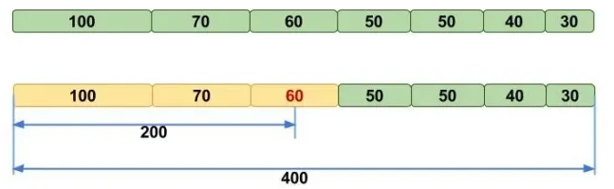
Evaluating genome assemblies
Total sequence: is it what is expected?
N50 metric: the length of the shortest contig (scaffold) for which longer or equal length contigs (scaffolds) contain at least 50% of the total assembly
Consensus quality: can be measured with accurate reads
Image credit: molecularecologist.com

Slide 80
Genome assemblers
Hifiasm -- for PacBio hifi, can use HiC to resolve haplotypes, uses string graph, a variant of the OLC strategy
Flye -- for Oxford Nanopore (and PacBio hifi), uses string graph
MaSuRCA -- for hybrid data sets – uses both DeBrujn and OLC
POLCA – polishing assemblies with Illumina reads
SAMBA – scaffolding assemblies with ONT reads
YaHS – for scaffolding assemblies with HiC reads

Slide 81
MaSuRCA
Originally designed for short Illumina reads
Enables hybrid assembly, ONT + Illumina, or PacBio CLR + Illumina
Additional tools:
POLCA
SAMBA
ufasta
module load masurca

Slide 82
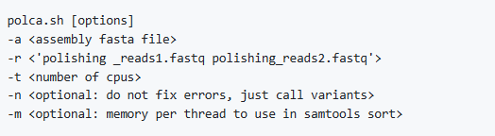
MaSuRCA - POLCA
Polishing tool to fix errors in contigs
Can be used for variant calling (convenient!)
Evaluate contig sequence quality
Usage:

Slide 83
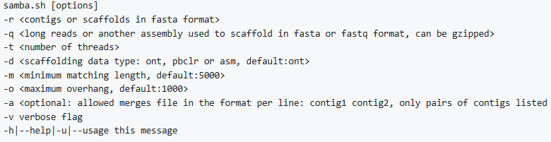
MaSuRCA - SAMBA
Scaffolding tool to improve contig sizes with long reads (ONT/PacBio)
Can be used to improve assemblies with additional data without complete re-assembly
Can be used to close gaps in scaffolds
Usage:

Slide 84
MaSuRCA - ufasta
Multi-purpose tool to work with fasta files
Extract records by name, random sample
Reverse complement
Format
Compute statistics
N50
Averages
E-size
Count

Slide 85
MaSuRCA - ufasta
ufasta can take input from file or pipe
ufasta usage:
ufasta n50 -a, –NXX, –S, –C
ufasta extract -f names.txt, –n single_name, -v
ufasta format
ufasta one
ufasta rc

Slide 86
Hifiasm
Used for PacBio HiFi data
Can do haplotype-resolved assemblies with HiC data
Fast and accurate
Error corrects reads, uses string graph with exact overlaps
Basic usage: hifiasm --primary -t 16 reads.fastq

Slide 87
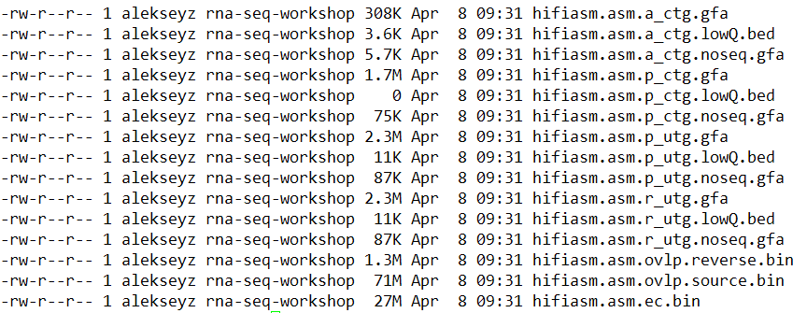
Hifiasm
Outputs:

Slide 88
Hifiasm
Overlaps and error corrected reads; computing these files takes the most time. You can keep them to quickly rerun with different parameters.

Slide 89
Hifiasm
Raw uniquely assemble-able contigs (unitigs), with small bubbles

Slide 90
Hifiasm
Primary uniquely assemble-able contigs (unitigs), without small bubbles

Slide 91
Hifiasm
Primary contigs

Slide 92
Hifiasm
Alternative contigs

Slide 93
Hifiasm
Use gfatools to convert gfa to fasta
module load gfatools
gfatools gfa2fa hifiasm.gfa > hifiasm.fa

Slide 94
Flye
Assembly of Oxford nanopore reads (and others)
Not haplotype-aware
Can assemble metagenomic data sets
module load flye
Basic usage for 200Mb (est) genome: flye -t 16 --nano-raw reads.fastq -g 200M

Slide 95
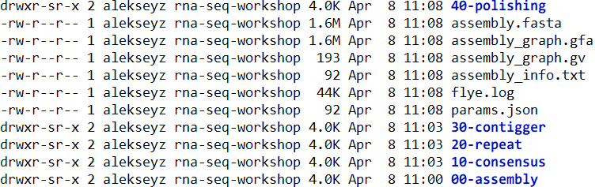
Flye
Outputs:
Assembled scaffolds
Assembly log, information about the assembly

Slide 96
Flye
Outputs:
Assembled scaffolds
Assembly log, information about the assembly

Slide 97
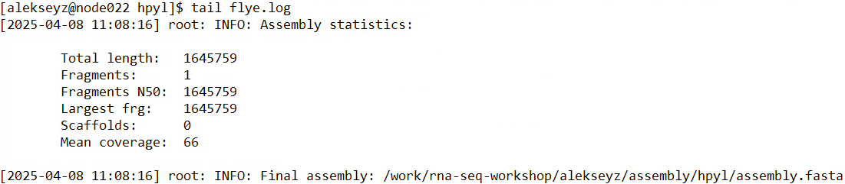
Flye
Outputs:

Slide 98
Interactive shell in Boqueron
It is convenient to use an interactive shell
srun --mem 16000MB --pty bash
Gives you an interactive shell with 16GB of RAM
Home directory ~/ is read-only
You can use /work/rna-seq-workshop/your_user_name/

Slide 99
In-class exercise: genome assembly
Use reads provided by PacBio (Hifi) for H. pylori
Run hifiasm, get fasta with gfa2fa
Run flye
Align the two assemblies with nucmer, followed by delta-filter -1. Are they the same?
Use nucmer show-aligns to visualize the differences show-aligns out.delta sequence1 sequence2 | less
Look for ‘^’ character for differences: type /\^[Enter] in less

